Slide 1


Market Basket Analysis: Optimizing Product Pairings for Revenue Growth
A Collaborative Analysis by UNCW MS Business Analytics Team

Slide 2
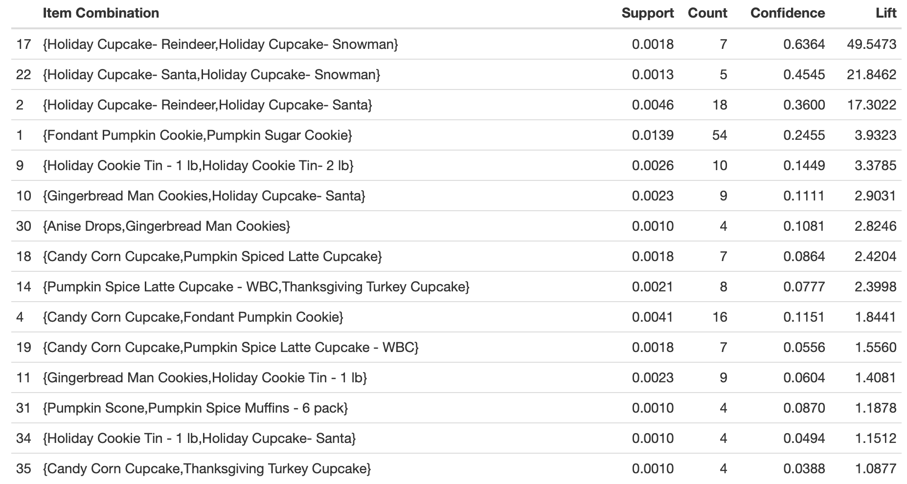
Seasonal Market Basket Analysis
Top Pairings
Holiday Cupcake combinations show extremely strong associations (17-49 Lift). Fondant Pumpkin Cookie with Pumpkin Sugar Cookie show moderate association (3.9 Lift) with highest volume of transactions.
Note: Lift values above 1 indicate products purchased together more frequently than by random chance.

Slide 3
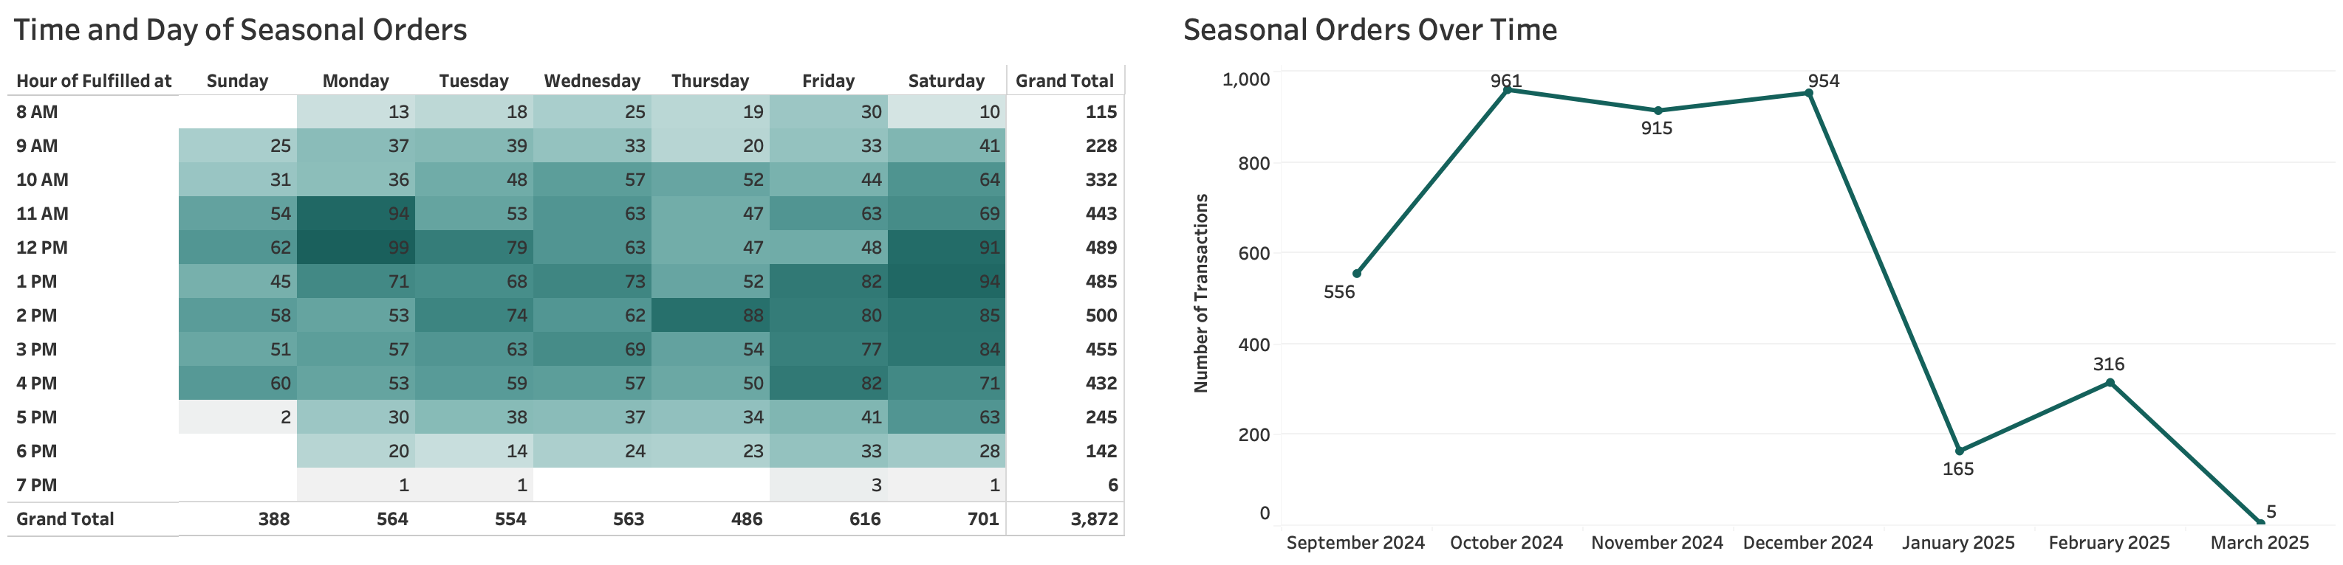
Seasonal Metrics - Overall
Peak ordering hours (11AM-1PM) suggest optimal staffing and inventory preparation times during holiday season.

Slide 4
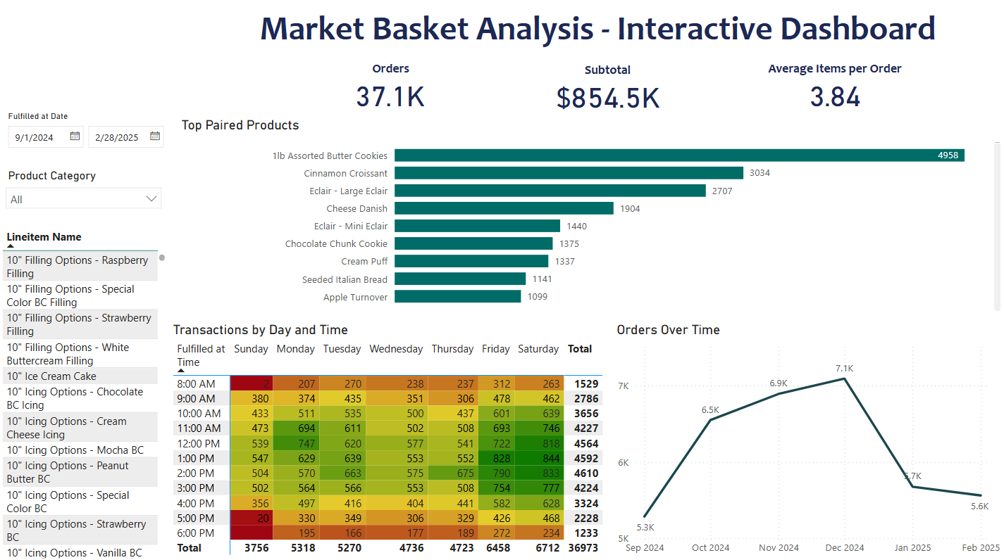
Interactive Dashboard – Image for Business Anonymity

Slide 5
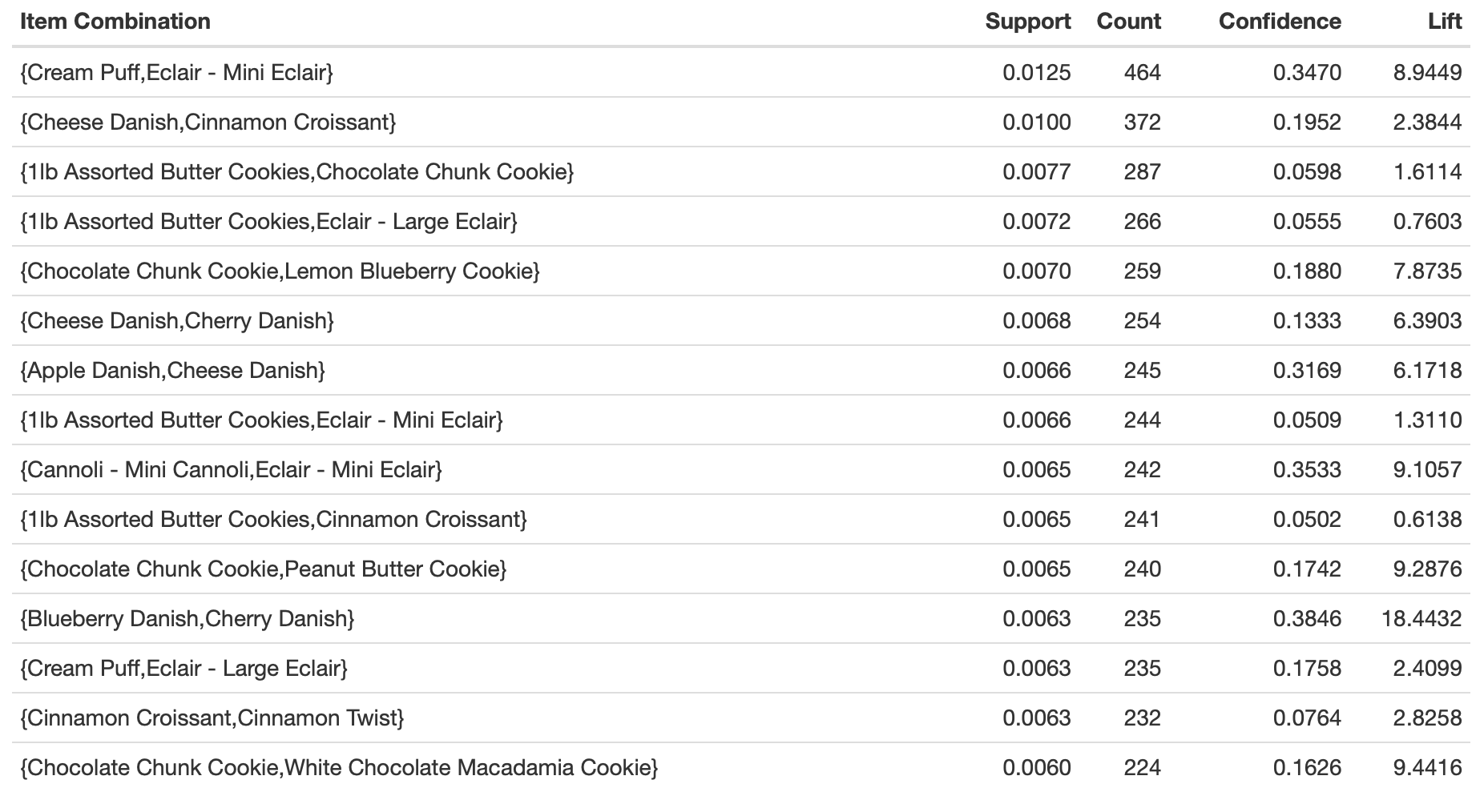
Year-Round Market Basket Analysis
Top Pairings
Cream Puff & Mini Eclair: High volume (464 transactions) combined with strong association (8.9 Lift, 34% confidence)
Cannoli & Mini Eclair: Strong preference (9.1 Lift, 35% confidence) indicates these items are frequently chosen together
Blueberry & Cherry Danish: Exceptional association strength (18.4 Lift) despite moderate transaction volume (235)
Chocolate Products: Form strong clusters with White Chocolate Macadamia (9.4 Lift) and Peanut Butter Cookie (9.3 Lift)

Slide 6
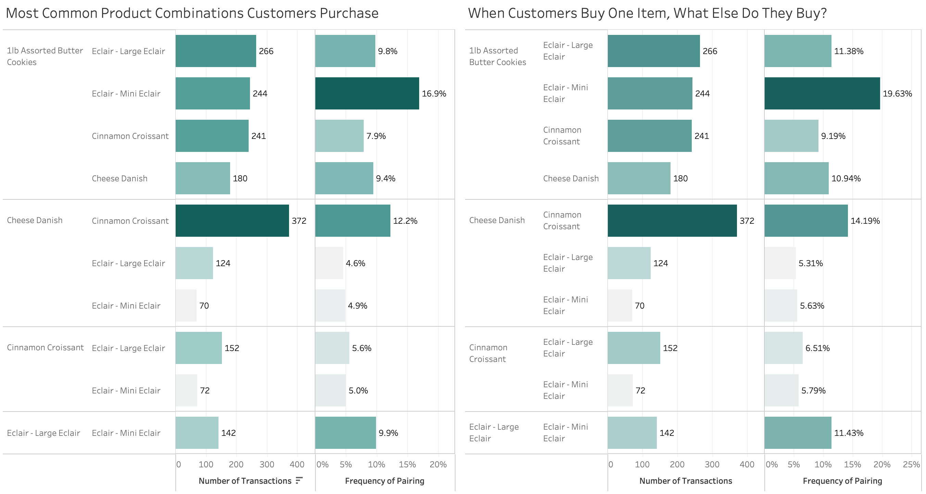
Market Basket & Product Affinity Analysis
Percentages show how likely customers are to buy the paired item when they purchase the base item.
Percentages show how common each pairing is across ALL transactions.

Slide 7
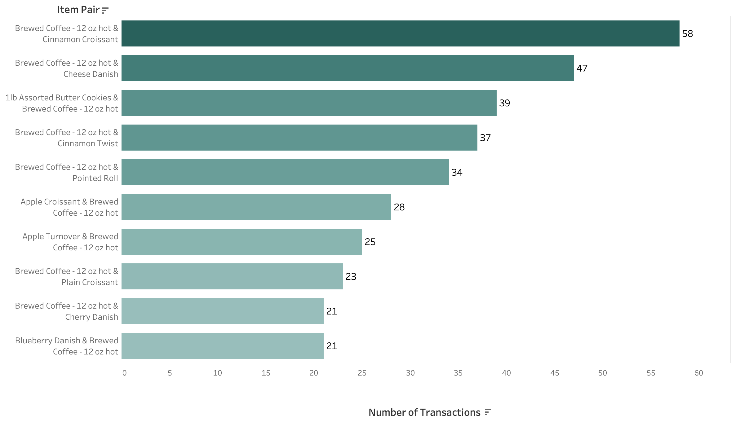
Market Basket Analysis - Coffee

Slide 8
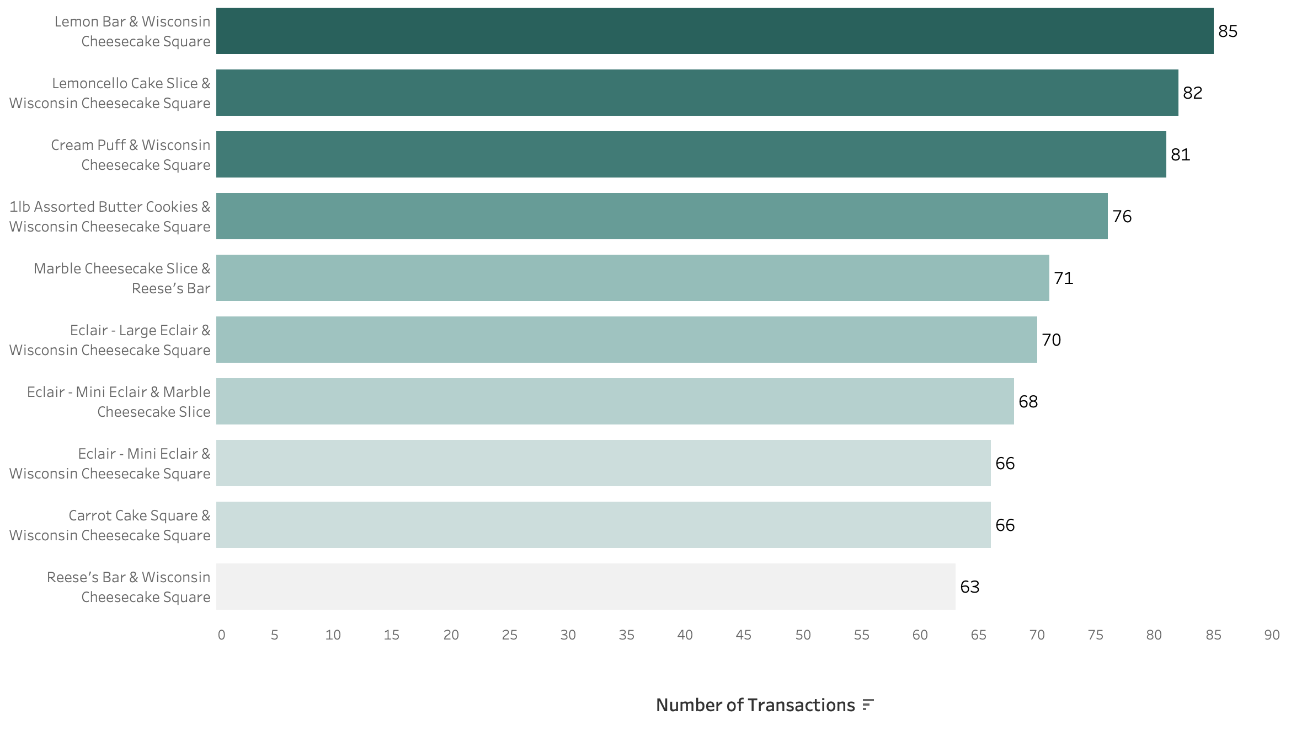
Market Basket Analysis – Cheesecake

Slide 9
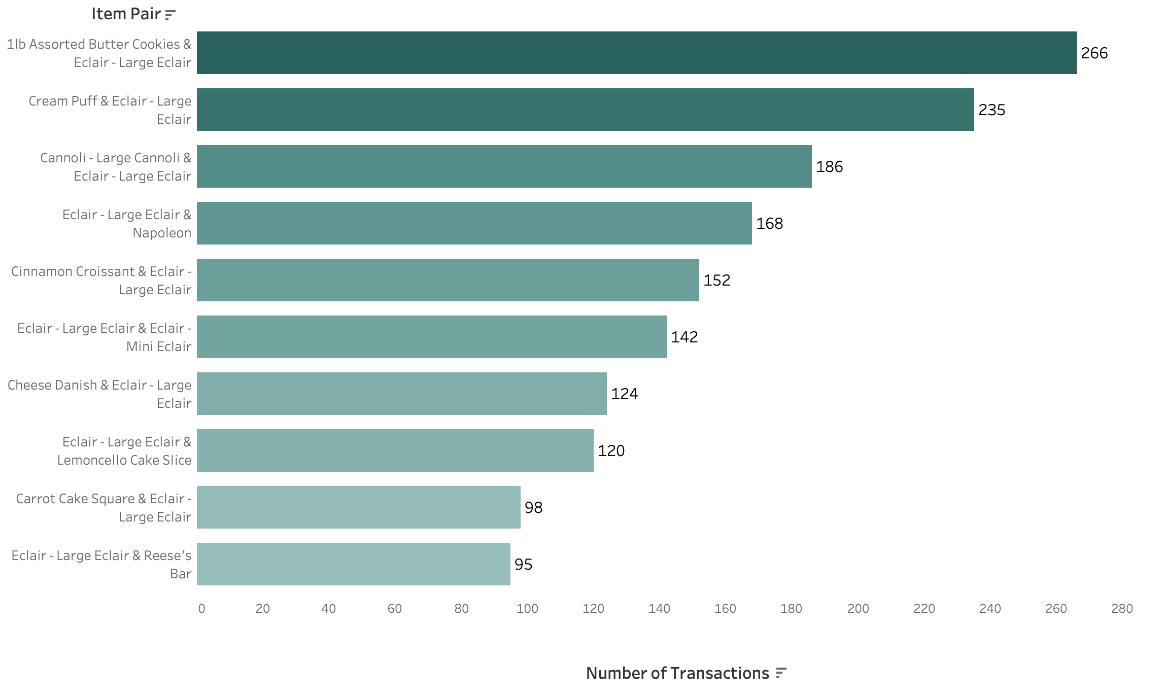
Market Basket Analysis – Large Eclairs

Slide 10
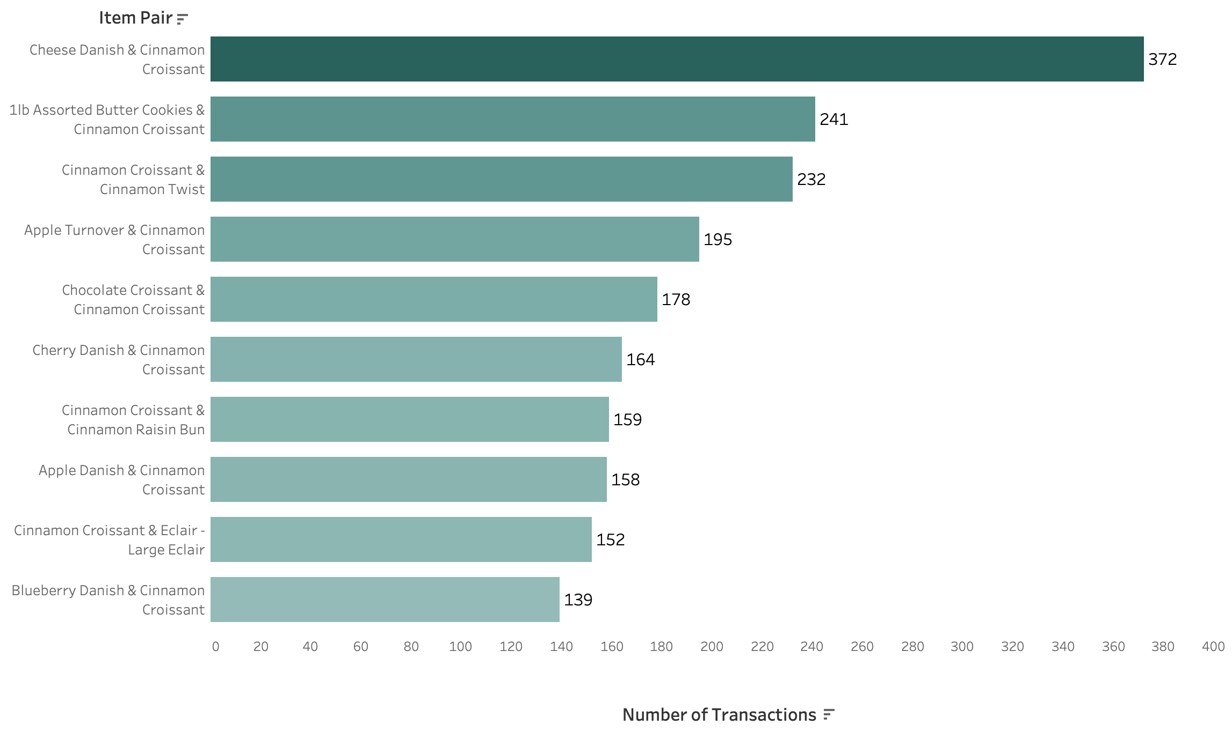
Market Basket Analysis – Cinnamon Croissants

Slide 11
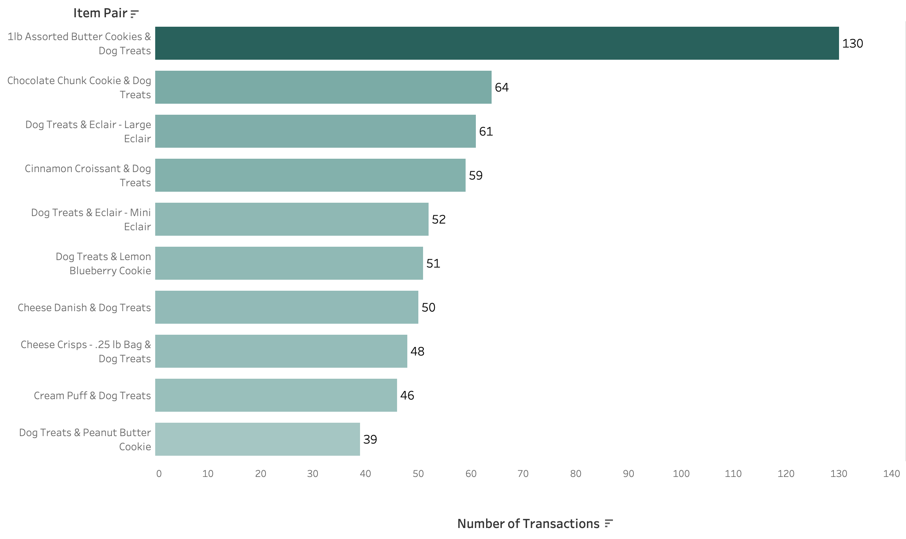
Market Basket Analysis – Dog Treats

Slide 12
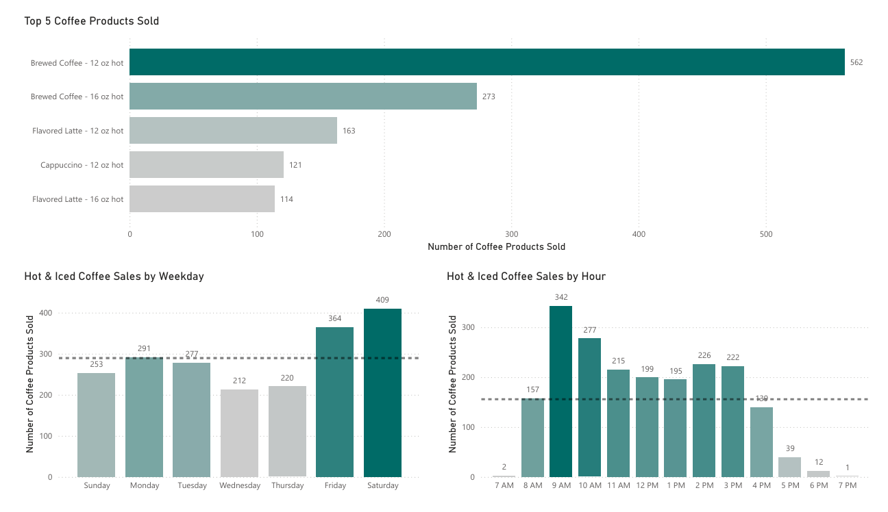
Coffee Analysis

Slide 13
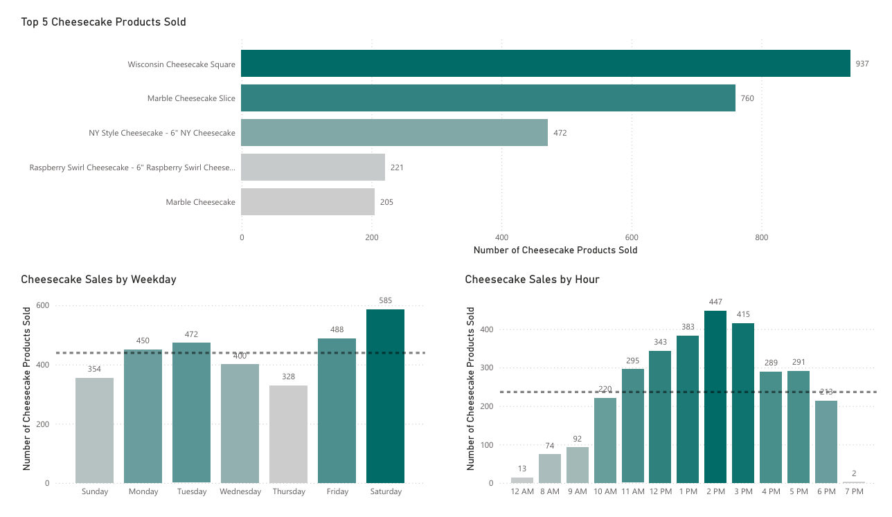
Cheesecake Analysis

Slide 14
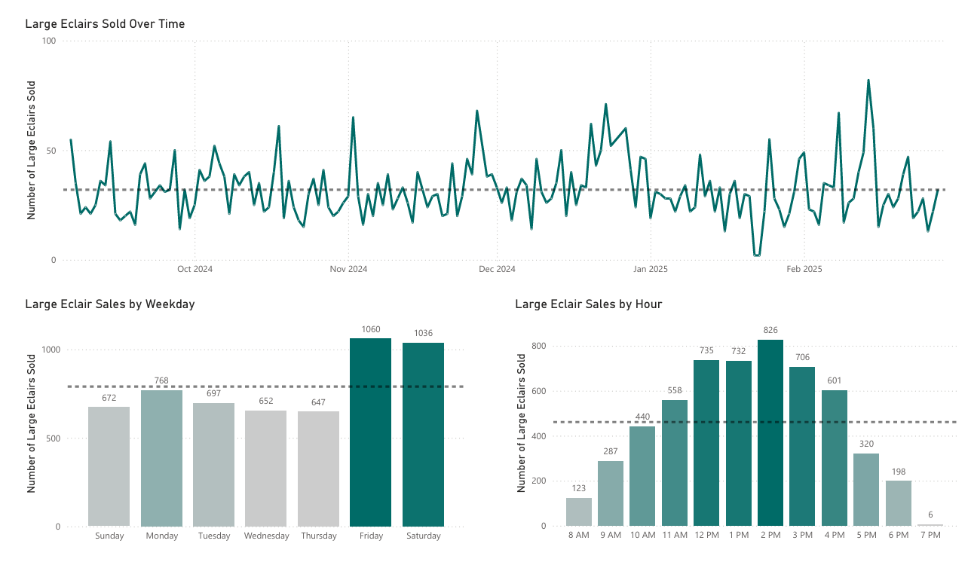
Large Eclair Analysis

Slide 15
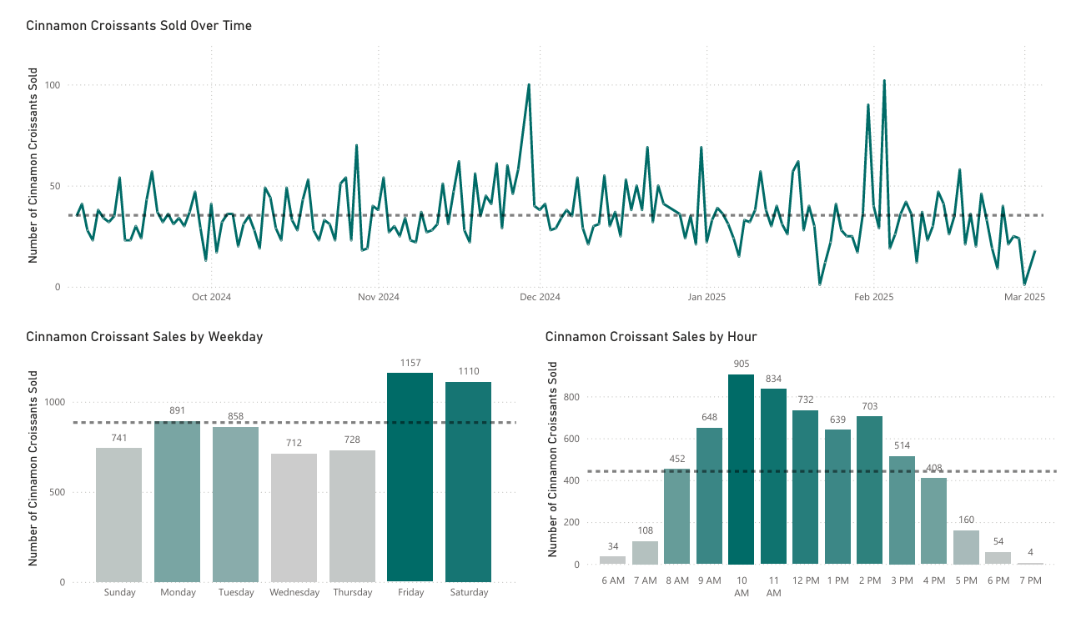
Cinnamon Croissant Analysis

Slide 16
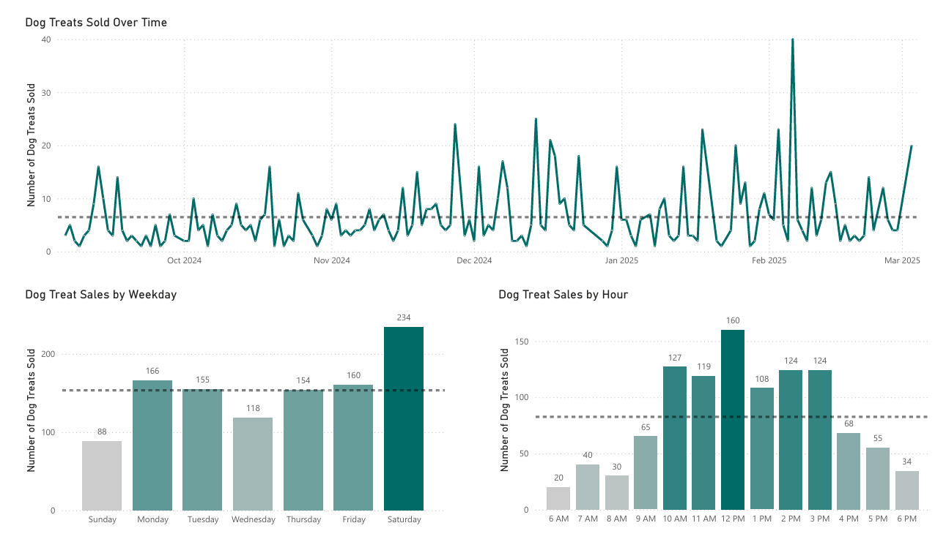
Dog Treat Analysis

Slide 17
Actionable Recommendations
Staff Pairing Suggestions Year-Round (Peak: Saturday 11AM-1PM, Coffee Peak 9AM-10AM)
Cinnamon Croissant
Suggest with Cheese Danish (372 transactions, 14.2% pairing rate)
Pair with Butter Cookies (241 transactions)
Recommend with coffee (58 transactions)
Large Eclairs
Recommend with 1lb Assorted Butter Cookies (266 transactions)
Suggest with Cream Puff (235 transactions)
Pair with Cannoli (186 transactions) or Napoleon (168 transactions)
Cheesecake (Wisconsin Square)
Pair with Lemon Bar (85 transactions)
Suggest Limoncello Cake Slice (82 transactions) or Cream Puff (81 transactions)
Offer with 1lb Assorted Butter Cookies (76 transactions)
Coffee
Recommend Cinnamon Croissant (58 transactions)
Suggest Cheese Danish (47 transactions)
Offer with 1lb Butter Cookies (39 transactions) or Cinnamon Twist (37 transactions)
Seasonal Recommendations (Peak: Oct-Dec)
Promote Holiday Cupcake combinations which show exceptional lift values (17-49).
Feature Fondant Pumpkin Cookie with Pumpkin Sugar Cookie during fall season.
Adjust staffing for peak seasonal ordering hours (11AM-1PM).
Prepare inventory for October-December transaction spike.
Strategic Sales Recommendations 1. Optimized Staffing
Schedule top performers during peak hours:
2. Bundle Offers
Offer coffee as an add-on to any pastry or cake slice
Suggested add-on price: $1–$2 (maintaining <50% cost margin)
Goals:
Highlight value of in-house coffee
Convert "coffee-only" buyers to pastry customers
Increase in-store time → increase spend per visit
3. Loyalty Program Rollout
Two-tier punch card system:
Tier 1: Coffee Only
Tier 2: Coffee & Pastry Combo
Reward: Free item on 10th purchase
Long-term enhancement:
Birthday rewards
Weekly specials & flash sales via opt-in.
Implementation Guide
Train staff to focus on the top pairing for each key product first.
Ask if they would like to add coffee to order when a customer buys Pastry items.
Staff those familiar with the coffee machine during peak sales periods.
Use data-specific language like "customer favorite pairing" or "most popular combination".
Create small table cards highlighting these "Perfect Pairings" near register.

Slide 18
Actionable Recommendations - Continued
Operational Efficiency Opportunities
BOH Cross-Training for Coffee Operations
Cross-train one BOH employee on coffee machine
Deploy during peak hours (heatmap-identified)
Expected impact:
Faster coffee order turnaround
FOH staff stays focused on customer engagement and upselling
2. Data-Driven Prep Sheet & Sales Forecasting
Continue importing weekly POS data
Tools provided:
Data structure template
Prep sheet template using 4-week moving averages
Benefits:
Informed prep decisions
Efficient BOH labor usage
Waste reduction
3. End-of-Life (EOL) Product Optimization
Current: Donate food past internal shelf-life to food banks (commendable)
Recommendations:
Partner with UNCW student orgs or campus dining
Sell at discount, not just donate
Increase brand visibility & reduce costs
Host campus study nights or meetings in-store after hours
Sell EOL items at discount
Drive coffee sales and student traffic

